Slide 1
Author: Alessandro Ferro ICTSAS505 Task 1
Author: Alessandro Ferro

Slide 2
1. Preparing documentation expressing how to evaluate impact of business continuity
To properly evaluate how the disruption of a system would impact business continuity, and to prepare the appropriate documentation, some information must be gathered:
Business critical functions: They can vary depending on the business, but some are common pretty much every business. These are:
Financial functions
Payroll functions
Administrative functions
Customer service functions
In a similar manner, which data and software are critical to business continuity must be understood. These information can be retrieved from available documentation, such as:
ISO
Management reports
Audit reports
Maintenance logs
Customer satisfaction reports

Slide 3
Once the previous steps are accomplished, the threats that can compromise the assets, information and functions of the business need to be identified.
For IT related companies, the most common threats are:
Cyber attack
Denial of service
Accident
Espionage
Network failure
Sabotage
Security
Virus
Natural calamities

Slide 4
Now that all the vital information have been gathered, a strategy to prevent or minimise the disruption to business operations and to define the approach to disaster recovery, can be documented.
The strategy will need to keep in account some legal, commercial and practical aspects, to be viable.
Statutory requirements:
Industry standards
Privacy and confidentiality
Legal requirements
Commercial requirements:
Availability/Accessibility (backup, storage, data recovery)
Security (hacking, firewalls, passwords, logins)
Confidentiality (encryption)
Practical constraints refer to the budget available, the hardware, software, legality and time constraints.

Slide 5
2. Prepare documentation expressing how to evaluate threats to system
To properly identify which threats the system can be subject to, the first step is to identify all the information relevant to the system itself.
Hardware, software and system interfaces
Data and information
Persons involved with the system
System mission and its value for the company
System architecture
Network
Technical, management and operational safeguards
Physical security environment
Environmental security.
All of these information can be gathered through questionnaire to the personnel, through on-site interviews, in the system documentation and with the use of automated scanning tools.

Slide 6
With the system well understood and assessed, the identification of the threats can now start.
Threat source can either be Natural, Human or Environmental.
Natural threats include any natural event that can cause damage. They can have catastrophic proportions, such as flood, earthquakes, tornadoes and so on.
Natural sources are difficult or impossible to predict and their likelihood to happen highly depends on the location of the business (a snow storm in the Sahara desert is highly unlikely).
Environmental sources of threats include pollution, liquid leakage, chemicals, etc.
Human threats can either be intentional or unintentional acts. Unintentional acts can be caused by poor training or simply by mistake.
Intentional acts can be benign in nature, when the motivation of the person compromising the security of the system is aligned with the interests of the company.

Slide 7
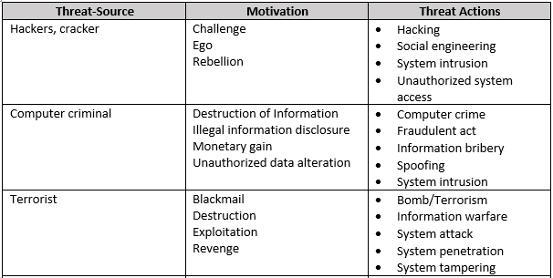
Malicious intentional acts include a wide category of threats source, in which different motivations play a major role.

Slide 8
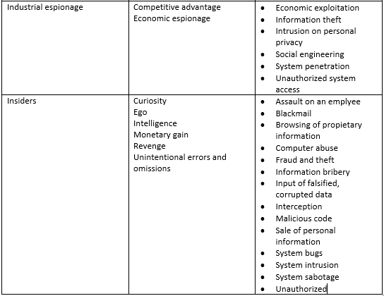

Slide 9
The system can be more susceptible to some of the threats than the others, therefore it is important to identify the vulnerabilities of the system to plan for a meaningful prevention and recovery strategy.
When the risk and the vulnerabilities have been assessed, it’s time to identify the options available to mitigate the risks.
Viable risk mitigation can be achieved through:
Risk assumption: The risk is considered acceptable or safeguards are implemented to bring it to acceptable levels.
Risk avoidance: The cause or consequence of the risk is eliminated
Risk Limitation: Safeguards to limit the risk’s adverse impact are implemented
Risk Planning: Risk is managed through the development of a risk mitigation plan
Research and acknowledgement: The vulnerability is acknowledged and research is done to identify controls to correct the vulnerability.
Risk transference: The risk is transferred by using other options to compensate for the loss caused by it.

Slide 10
3. Prepare documentation expressing how to formulate prevention and recovery strategy
When planning for risk prevention and disaster recovery, it is important to consider which strategies are already in place in the company and if there are ways to adopt more cost effective measures.
With consideration for some of the most common risks in an IT related environment, there are prevention strategies that are useful to focus on.
Facility protection: Fire detection and suppression is required by the Australian law. Some of the more common measures include: Automatic fire suppression systems, Fire hose reel, Fire hydrants, Smoke detectors and alarms, Fire doors, Fire extinguishers, Solid-core doors, Smoke exhaust systems, Exit signs, Fire drenchers, Emergency lighting, Exit systems and paths to travel to exits.
Physical Security and Protection: To protect valuable assets and data from theft or corruption, the premises in which those are kept should be protected. Some ways to implement this form of protection are: Key card, Fingerprints, Face scanning, biometrics, Security patrols, Surveillance, Lock and key.

Slide 11
Power protection and Continuity: Almost all the machines and machinery used in a company need electricity to be able to operate. Power issues can heavily compromise a business productivity and can come in various forms:
Blackout: Complete power cut
Brownout: Noticeable power drop
Surge: Power spike that exceed the standard voltage.
To face the effects of problems with the electricity supply, a company can adopt the following strategies: UPS, Stand-by generators, Surge arrestors.
Water damage protection: Water leaks or the malfunction of other water based systems can easily damage electrical devices and hardware. A water leakage can be not as immediately noticeable as a blackout or as a flood, but nonetheless can have harmful consequences for a business. The best protection from this kind of problems is prevention, which can be achieved by using a Water Leak Detection System.

Slide 12
IT System Protection: IT systems are constantly subject to external attacks. This applies even more for business that handle valuable assets and information. These are the strategies that can be adopted for protection: Firewalls, Password authentication, Intrusion detection, Encryption and Public keys, Vulnerability testing, User rights, Anti-virus software, OS and application software patching and updating, Security policies.
Data protection/Preservation: There are numerous reasons that can lead to the loss or the corruption of data and it’s important to have a backup plan in place to avoid. The common backup strategies are: Tape, Disk mirroring, RAID, Cloud hybrid, Cloud.
Business Continuity Strategies: Although prevention is always the best strategy, sometimes disasters cannot be avoided and a strategy to keep the business running should be adopted. In an IT environment, this is usually achieved with Hot Standby or with Warm/Cold Standby.
Once a prevention and recovery strategy has been defined, a set of Operation reviews should be undertaken by the management to assess the effectiveness of the processes.

Slide 13
4. Prepare documentation expressing how to develop disaster recovery plan to support strategy
For the implementation of a disaster recovery plan the first step is the identification of the resources required. These can be Hardware, Software and buildings.
Human resources are also a necessary part to consider when planning for disaster recovery and can be organised by category as Operational team, Disaster Response team and Disaster Recovery team.
Once the resources have been identified, the necessary procedures need to be outlined, to define the responsibilities and what need to be performed for disaster recovery. In this step is important to consider that different departments should be involved and must be able to operate together for the same goal.
Another aspect that need not to be underestimated is the criteria to adopt to declare a disaster. Creating a plan that tries to include every possible scenario is one way to do this, but it’s important to remember that human judgment is still the key factor.

Slide 14
Lastly, a disaster recovery plan should be documented following the appropriate standard and complete with all the relevant information. The standard can be set by government or international organization (ISO, AS), by the organization or could also be relevant standards specific to the project.
e.g.:
Proper pagination format
Company information
Objective and scope of the plan
Business processes and assets
Risk and vulnerabilities
Disaster Prevention, Response and Recovery Strategies and Procedures
Strategies and responsibilities
Disaster declaration, updating and testing
Disaster Recovery Plan Implementation

Slide 15
Other important information that should be part of a disaster recovery plan are the cut-over criteria. These would specify the cut-over authorisations, the actual system down time and would estimate the impact on the business.
In conclusion, a disaster recovery plan should contain all the information and processes that would allow a business to survive and/or keep operating at best in case of an expected or unexpected adverse event.

